Slide 1

DATACO SUPPLY CHAIN ANALYTICS
USING SQL SERVER DATA WAREHOUSING AND POWER BI
Saleem Khaled

Slide 2
Brief description of the problem being solved
The project addresses the need to analyze and improve DataCo Global’s supply chain performance.
The objective is to structure transactional data (180k+ orders from 2015–2018) to provide meaningful insights into delivery status, costs, and profit metrics.
Overview of the proposed solution
Building a complete SQL Server Data Warehouse using the Medallion Architecture (Bronze → Silver → Gold layers).
Developing interactive Power BI dashboards to consume the Gold Layer data and support strategic decisions.
Unique value proposition
The outcome is a fully modeled warehouse and interactive BI dashboards designed to enable Executive BI Reporting and optimize operations.
The structured approach ensures data reliability, consistency, and traceability across three layers (Bronze for raw integrity, Silver for cleaning/standardization, Gold for business readiness)

Slide 3
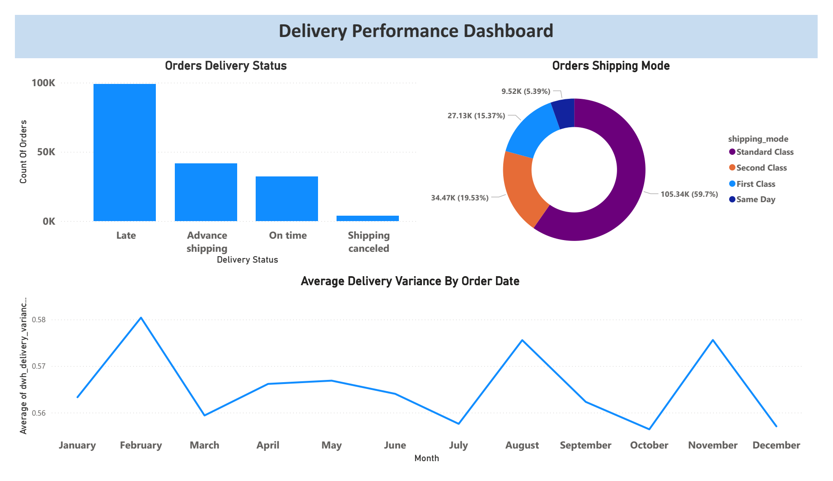
Visual representation of key user interfaces
The data journey moves from CSV source files (e.g., DataCoSupplyChainDataset.csv) through the Bronze Layer (raw data) to the Silver Layer (cleaned data), and finally into the Gold Layer (star schema views) optimized for Power BI consumption.
• Focus on usability and user experience:
◦ The Power BI dashboards should emphasize visual interactions and drill-down analytics for region, product, and customers.
◦ The Gold Layer ensures the data model is simple and fast for BI reporting

Slide 4
Define primary user personas
◦ Strategic Decision Makers / Executives: Users who rely on the reports for metric validation and the business insights narrative.
◦ Supply Chain Managers: Focused on Delivery Performance and optimizing Shipping & Operational Costs.
◦ Product/Regional Managers: Focused on Product, Regional, and Customer Insights.
Key features that address user needs
◦ KPI Dictionary with DAX: Provides defined metrics such as On-Time Delivery Rate, Average Shipping Cost per Order, and Order Fulfillment Cycle Time.
◦ Cost Fact Tables: Enable analysis and optimization of shipping and operational costs.
◦ Cleaned Dimensions: Dimension tables for Customer, Region, Product, Department, and Date ensure consistent context for analysis.
how the features solve the problems of each end-user:
◦ The Power BI dashboards provide dynamic, executive-level reporting, allowing managers to drill down into specific areas (like late deliveries by country/region) to identify issues and formulate strategy.

Slide 5
Description of the database architecture
◦ The project utilizes the Medallion Architecture (Bronze, Silver, Gold) implemented fully within SQL Server.
◦ Data is sourced from CSV files (e.g., DataCoSupplyChainDataset.csv).
Key entities and relationships between data points
◦ The Gold Layer uses a Star Schema data model.
◦ Fact Tables: Include data for Orders, Shipping, Delivery, and Financials.
◦ Dimension Tables (dim_): Include entities like Customer, Region, Product, Department, and Date.
◦ Surrogate Keys (e.g., customer_key) are used for stable references in dimension tables.
Data flow (how data is collected, stored, and accessed)
◦ Data is collected via CSV → SQL ingestion into the Bronze Layer (Raw Data, no transformations).
◦ The Silver Layer handles Data Cleansing, Deduplication, Standardization, and Normalization.
◦ The Gold Layer applies Data Integration, Aggregations, and Business Logic, outputting Business Ready Views optimized for Power BI reporting.

Slide 6
the main programming languages used
◦ SQL/TSQL: Used for data transformations, analysis, and is documented as 17.6% of the repository languages.
◦ Jupyter Notebook: Documented as 82.4% of the repository languages.
frameworks/tools used
◦ SQL Server: The core platform hosting the Bronze, Silver, and Gold data layers.
◦ Power BI: Used for data modeling, creating DAX measures, and developing interactive dashboards.
supporting technologies
◦ DAX: Used specifically by Mohamed Mostafa to convert delivery KPIs into actionable metrics.
◦ The data warehouse uses Stored Procedures (following conventions like load_bronze, load_silver) to encapsulate ETL logic.

Slide 7
List of reports and documentation to be provided:
◦ The SQL Server Data Warehouse (Bronze → Silver → Gold).
◦ Interactive dashboards in Power BI.
◦ Power BI data model (.pbix).
◦ Complete ETL documentation (including Bronze / Silver / Gold ETL Logic and SQL Transformation Guide).
◦ Executive insights & recommendations.
◦ A KPI dictionary with DAX definitions.
Timeline for deliverables:
◦ The project adhered to an 8-Week Project Plan.
◦ Key internal deadlines included Week 4 for Silver/Gold Layer completion and Week 6 for Power BI data modeling and core DAX KPI setup.
Other final products:
◦ The fully documented Source Code Repository on GitHub (Selim9-9/Supply-Chain-Data-Analysis).

Slide 8
Team Member | Role | Key Responsibilities
Saleem Khaled | Project Lead, SQL Server Data Engineer | Bronze layer ingestion & initialization, raw layer setup, data quality checks, ensuring raw data integrity.
Abdelrahman Mohamed | Data Engineer | Silver layer transformations, data cleaning, standardization, deduplication, application of business rules.
Mohamed Mostafa | Data Warehouse/BI Modeler | Gold layer modeling (star schema), KPI development, DAX measures, business insights narrative, metric validation.
Mohamed Sameer | Power BI Developer | Power BI dashboard design, visual interactions, performance optimization, final dashboard development.
Collaboration methods:
◦ The team used a phased approach corresponding to the Data Warehouse layers (Bronze, Silver, Gold), implying clear handoffs of deliverables.
◦ Communication and issue tracking are handled via GitHub Issues

Slide 9
Thank You
Contact information for follow-up:
◦ Contact the Project Lead, Saleem Khaled, for warehouse inquiries.
◦ GitHub Repository: https://github.com/Selim9-9/Supply-Chain-Data-Analysis.
◦ Project Plan on Notion: https://garrulous-cake-5cd.notion.site/Supply-Chain-Analysis-Project-Plan-eaf8285b7a0c4c9ab311f08658e064c3.

